Slide 1

E-PROJECT…….!
01
Wilson sporting goods

Slide 2
02
Faculty Name : Miss Nashmia Khan
Coordinator Name : Miss Madiha Fatima
Batch Code : 2305f1
Students Name : Nehal aleem, AMIN BULAQI, FAHAD SHEIKH, SAMEER MALIK

Slide 3
03
E-Project Description :
WILSON SPORTING GOODS is selling various types of Sports Goods. The company advertises by distributing the pamphlets, advertising on television and so on. Due to rapid development in internet field, the company decides to launch a website where people will get all the information about the various products available with them easily.

Slide 4
04
This is how our site-map looks :
06
Nike
Clothes
Reebok
About us
Home
Contact us
Comparison
Spalding
Sports
Adidas

Slide 5
05
Users are able to do these tasks :
User end
Home
Products
About Us
Contact us

Slide 6
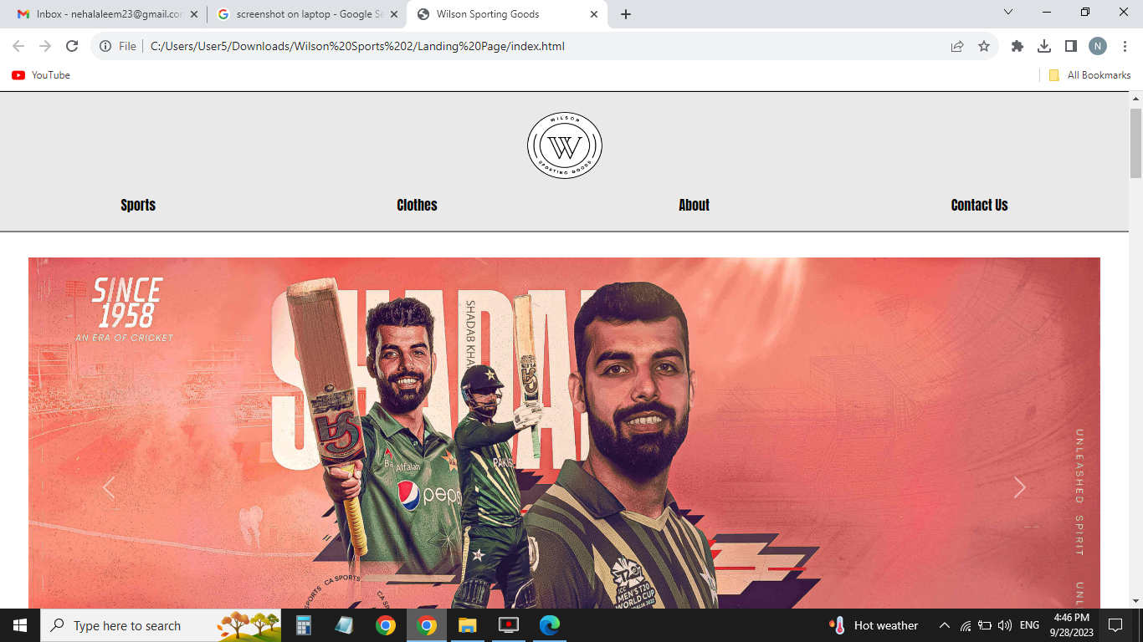
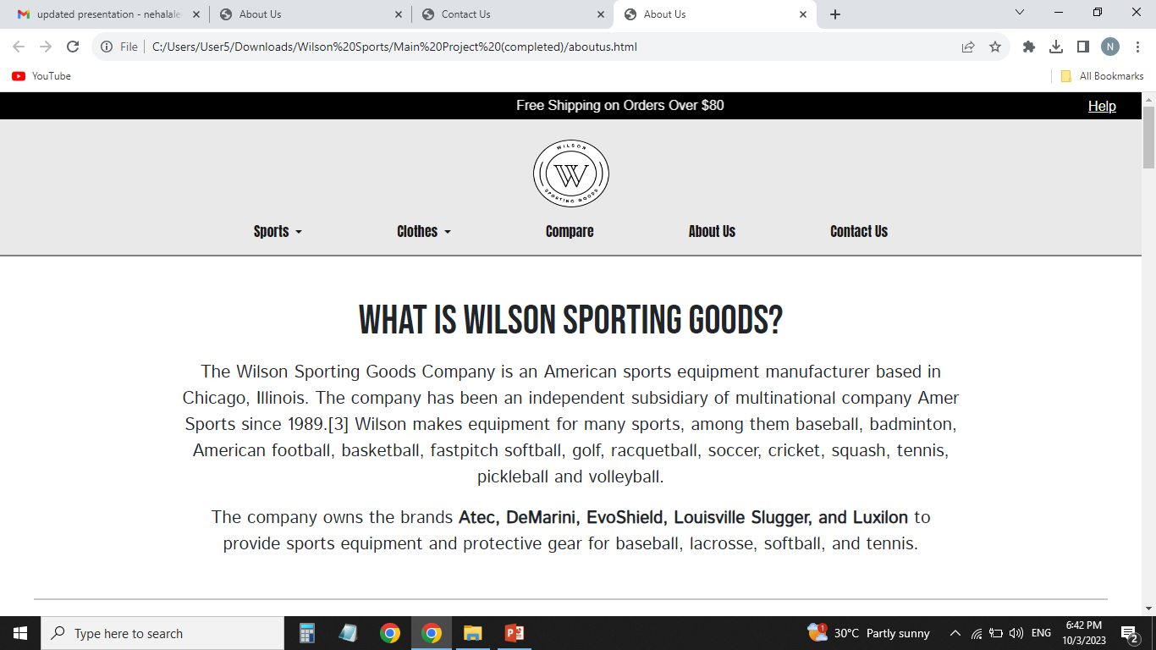
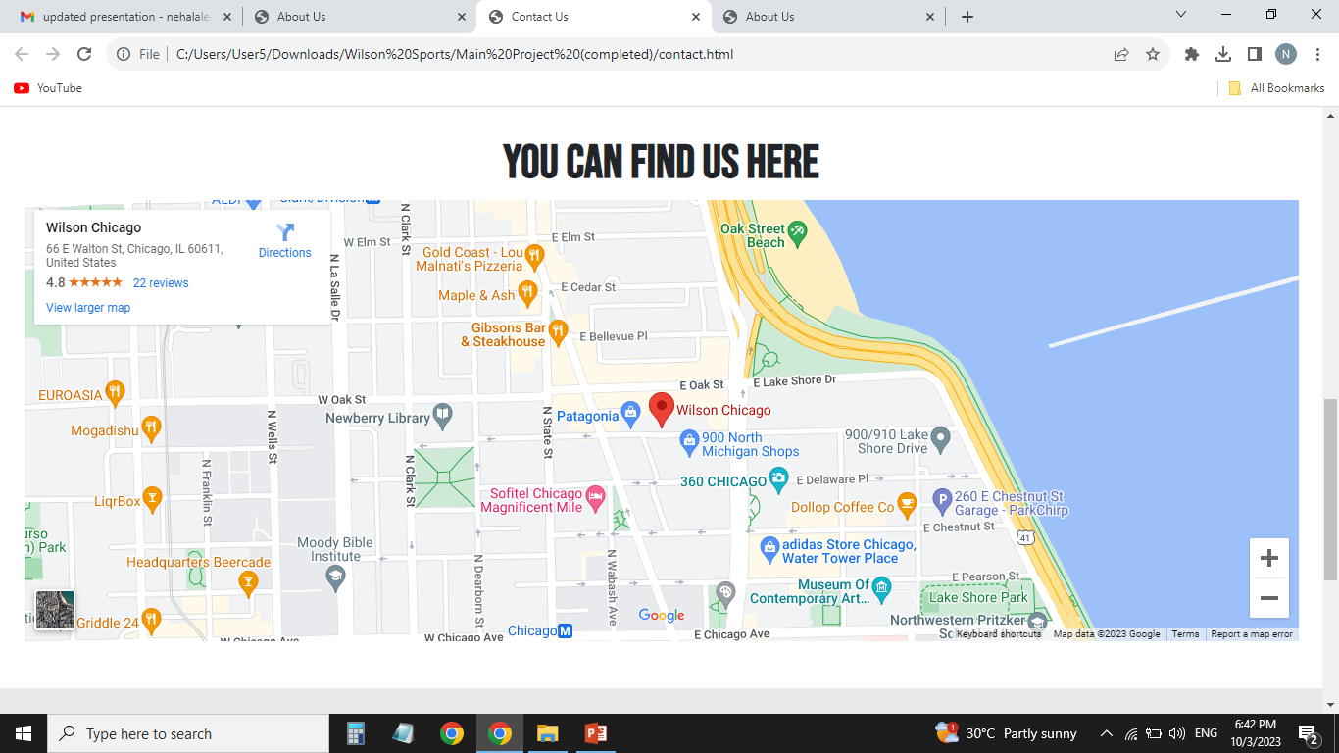
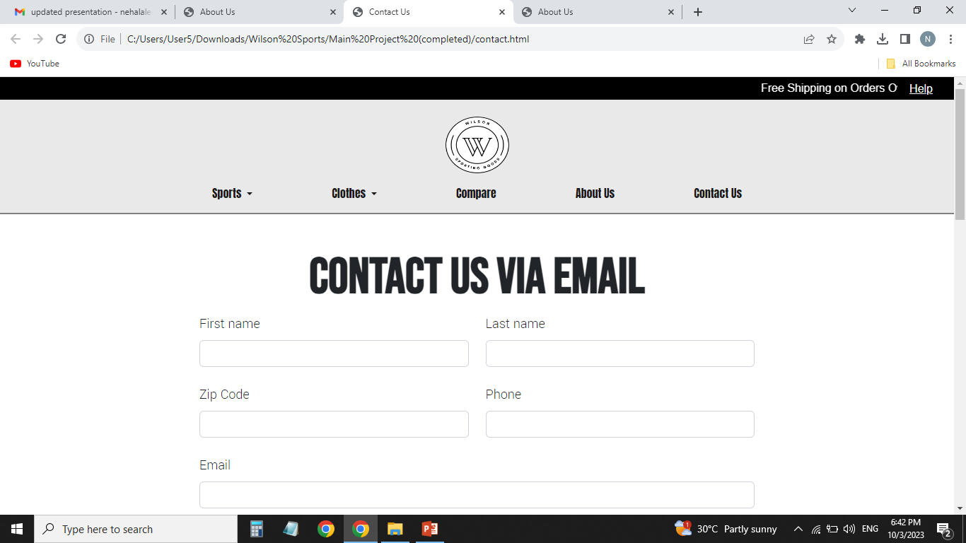
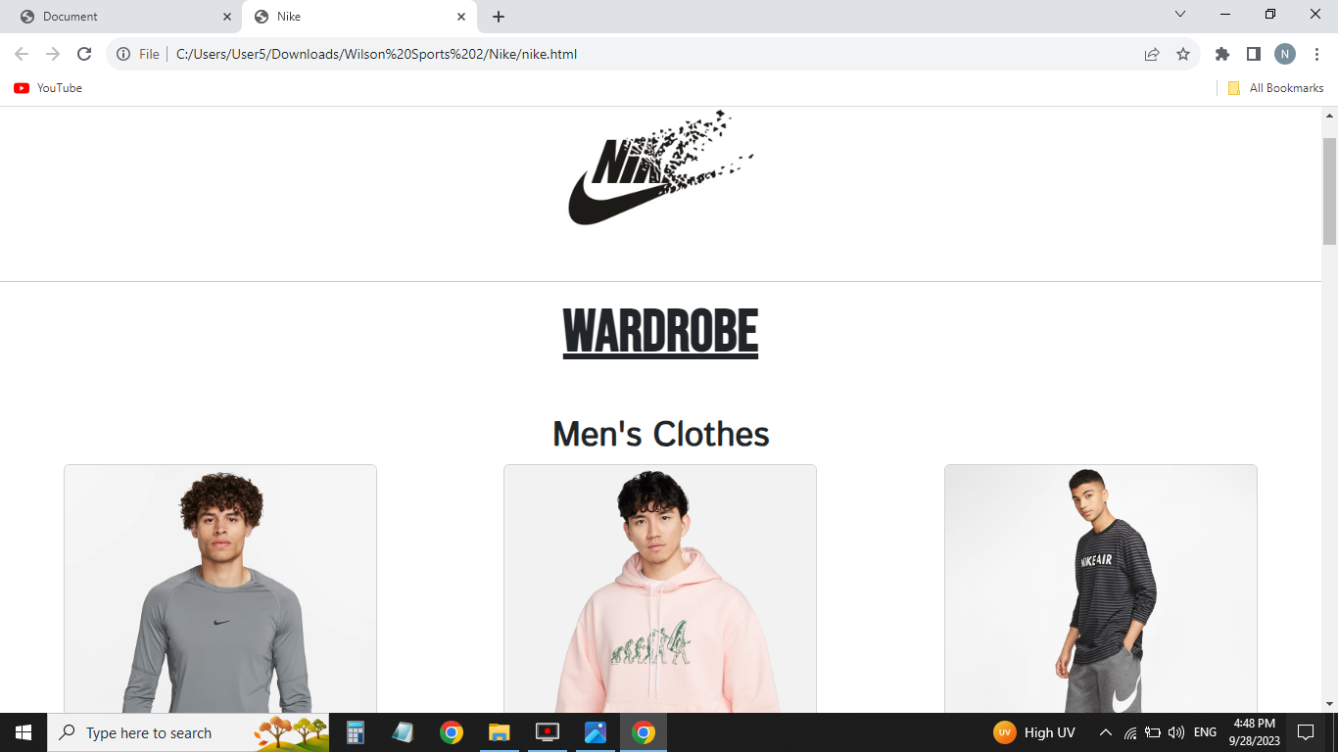
07
Admin can perform these tasks from Admin-End :

